Slide 1

Unit-V
MGN-502A
Leadership, Motivation and Control
p. b. Narendra Kiran
Assistant professor

Slide 2
Application of leadership theories
Learning outcome-
Students will be able to
1.Understand Leadership Styles
2.Analyse Leadership Theories
3. Application of leadership theories in various phases of GD Process

Slide 3
Activity
Name a leader of your choice.
Why the person is considered as a leader?
Identify his/her leadership traits.
Enlist the achievement of this leader.

Slide 4
Leadership
Leadership refers to the ability of one individual to influence others to change their behavior in order to achieve a shared goal.
The person influencing others (leader) possesses a set of qualities or characteristics with which he or she has to influence others.

Slide 5
DEFINITIONS
Leadership is the ability of a manager to induce subordinates (followers) to work with confidence and zeal.
—Koontz and O’Donnell
Leadership is the ability to awaken in others the desire to follow a common objective.
—R. T. Livingston

Slide 6
Leadership traits
https://www.youtube.com/watch?v=laDWCgWDzyE

Slide 7
LEADERSHIP TRAITS
Sympathy
Nurturing and caring
Uprightness
Direction
Communication
Flexibility
Complexity Resolution
Strategic Action
Innovation

Slide 8
IMPORTANCE OF LEADERSHIP
Clarity and Communication
Motivation
Change Management
Planning
Employee Relations
Crisis Management

Slide 9
Leaders v/s Managers
Manager
An officially designated authority
Responsible for controlling and supervision of sub-ordinates
Provides instructions to his subordinates
Main focus is on achievement of employees
Leader
An authoritative individual
Responsible for building trust
Provides a vision to believe in and strategic alignment
Trains and guides people and empowers them.
Main focus is on growth and development of employees

Slide 10
……………
Avoids risks
Negotiates and coerces. Balances opposing views
Takes risks when opportunities appear promising
Develops fresh approaches for solving problems

Slide 11
LEADERSHIP STYLES
Autocratic Style (Do What I Say)
Leader decides and instructs the team and the subordinates follow him and implement his decisions.
Employees play no role in decision-making.
Adolf Hitler is an example of the autocratic leaders.

Slide 12
Participative Style (Let Us Work Together)
Consultative: In this style leaders takes opinions from the group members before coming to the final decision.
Consensual: These leaders believe in motivating the group members to discuss on the issue and then arrive at a conclusion.
Democratic: In this style, each group member votes before the leader takes any decision. Here the entire authority lies with the group.

Slide 13
Supportive leadership
Supportive leadership involves building trust, inspiration, and helping colleagues overcome the challenges they encounter.
Leaders looking to be more supportive of their teams should try to encourage teamwork, pay attention to members' relationships and also show commitment.

Slide 14
Free-rein style (I Go and You Work)
Leader gives entire freedom to the group members to identify the goals and objectives, take decisions, and resolve issues.
For example, free-rein style of leadership occurs in research and development sections of industry.

Slide 15
Entrepreneurship leadership style
A charismatic personality that inspires others to do business with him.
A much stronger interest in dealing with customers than employees.
A strong dislike for bureaucratic rules and regulations.

Slide 16
MCQ
Michael is a type of manager who is concerned primarily with making decisions and dictating the same to followers. His behavioral style is called:
a. autocratic. b. democratic. c. task oriented. d. people oriented.

Slide 17
quiz
When followers are given free hand in developing goals and deciding courses of action to achieve the same this is called-
A. Supportive style
B. Laissez Faire style
C. Autocratic style
D. Entrepreneurship style

Slide 18
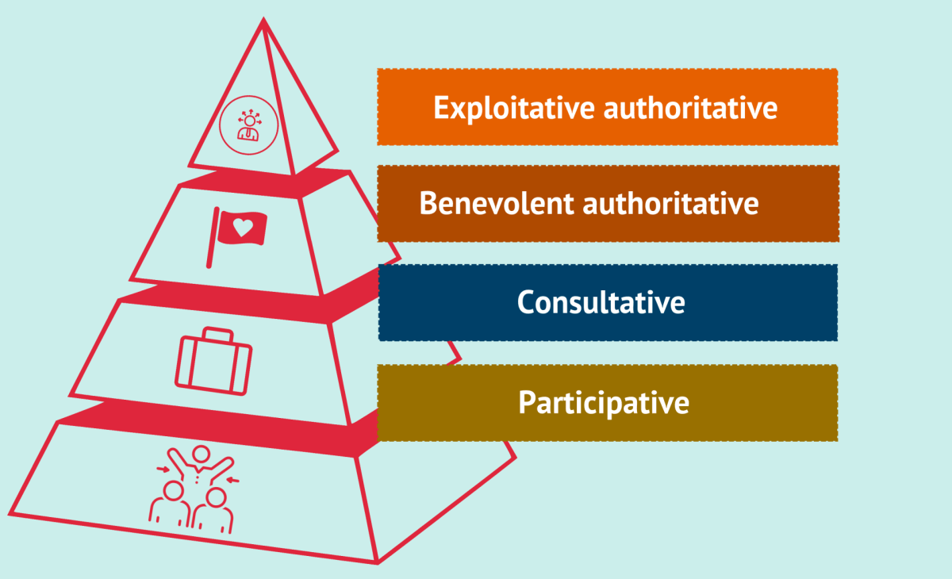
Likert’s Management systems in a Nutshell

Slide 19
Transactional Leadership Vs Transformational Leadership
BASIS FOR COMPARISON | TRANSACTIONAL LEADERSHIP | TRANSFORMATIONAL LEADERSHIP
Meaning | A leadership style that employs rewards and punishments for motivating followers is Transactional Leadership. | A leadership style in which the leader employs charisma and enthusiasm to inspire his followers is Transformational Leadership.
Concept | Leader lays emphasis on his relation with followers. | Leader lays emphasis on the values, ideals, morals and needs of the followers.
Nature | Reactive | Proactive
Best suited for | Settled Environment | Turbulent Environment
Works for | Developing the existing organizational culture. | Changing the existing organizational culture.
Style | Bureaucratic | Charismatic
How many leaders are there in a group? | Only one | More than One
Focused on | Planning and Execution | Innovation
Motivational tool | Attracting followers by putting their own self interest in the first place. | Stimulating followers by setting group interest as a priority.

Slide 20
Behavioral Theory
In contrast with trait theory, behavioral theory attempts to describe leadership in terms of what leaders do, while trait theory seeks to explain leadership on the basis of what leaders are.
Leadership according to this approach is the result of effective role behavior.
Leadership is shown by a person’s acts more than by his traits.

Slide 21
……….
Behavioral theory proposes that specific behaviors differentiate leaders from non leaders on the basis of the following:
Pattern of actions used by different individuals determines leadership potential

Slide 22
Advantages of Behavioral Theory
Promotes participative decision making and team development.
Helps managers find the right balance between different styles of leadership.

Slide 23
Disadvantages
The approach only focuses on the surface of people's issues such as their behavior. It fails to look at underlying causes such as what occurs in the human mind.
Some describe the approach as being very narrow and deterministic. For example it assumes that all behavior is learned when in fact some peoples actions are a result of what they have experienced in the past

Slide 24
MANAGERIAL GRID THEORY (Blake and Mouton)
Managerial grid is a graphical representation of two behavioral dimensions of a leader:
❑ Concern for People (Y-axis): This is the extent to which a leader accommodates the needs and interests of the team members and gives them priority while making a decision about best means to accomplish a task.
❑ Concern for Production (X-axis): - This is the extent to which a leader lays emphasis on tight schedules and high productivity while making a decision about best means to accomplish a task.
❑ The scale of grid ranges from 1 (low) to 9 (high), thus forming 81 positions.

Slide 25
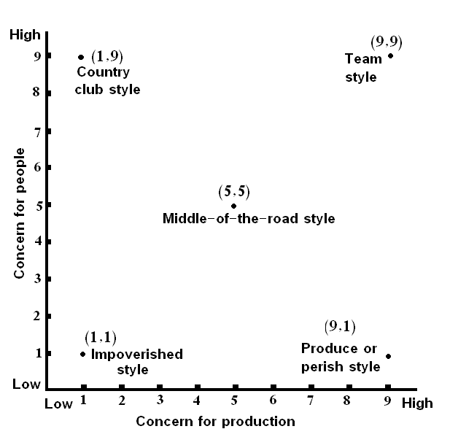

Slide 26
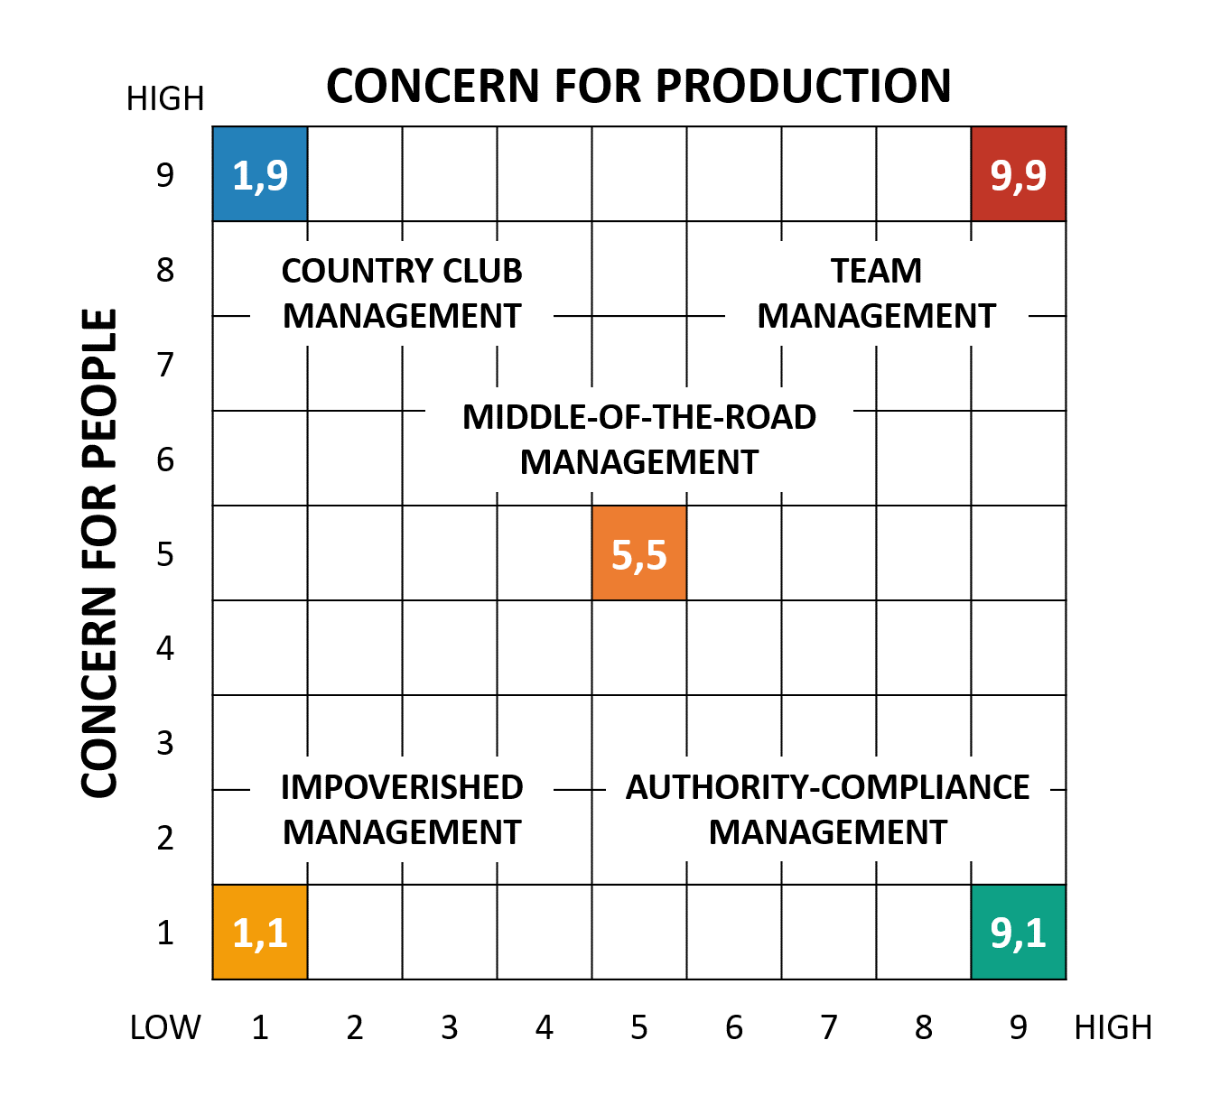

Slide 27
Advantages and disadvantages
Advantages:
Based on the information generated from the grid, leaders can decide the necessary changes to be made.
Disadvantages:
The model neglects the essence of internal and external limits which affects the working process

Slide 28
MCQs
What do you call a style of leadership that takes account of others' views, opinions and ideas?
a) Laissez-faire
b) Democratic
c) Autocratic
d) None of the above

Slide 29
2
A leadership style which empowers the followers to make decisions on their own is called as-
a) Free reign
b) Democratic
c) Autocratic
d) None of the above

Slide 30
Leadership Theory
GREAT MAN THEORY
It was proposed by Thomas Carlyle in 1840s
Leaders are born and not made
These leaders come out when need arises
Focused on ‘Man’ only as a leader

Slide 31
Criticism of Great Man Theory
Focused on ‘Man’ only as a leader but women too are great leaders.
Not all leaders are born. Some are made also.
This theory does not consider impact of other factors like subordinates, production, environment etc.

Slide 32
Leadership Theory
Contributors were Thomas Carlyle, Francis Galton and Ralph Stogdill
It specifies traits which enable a person to become successful leaders and differentiate them from ineffective leaders
Ralph Stogdill surveyed more than 5000 leadership studies and concluded that successful leaders must have 10 qualities.
Belif – Traits are in born and cannot be trained through learning
Features / Characteristics
TRAIT THEORY

Slide 33
Traits of TRAIT THEORY
These are some traits which enable a person to become successful leader.
Intelligent
Empathy
Social Skills
Technical skills
Objectivity and Fairness
Motivation
Communication Skills
Decisive
Vision

Slide 34
Leadership TRAITS
What characteristics or traits make a person a leader?
Trait theories of leadership sought personality, social, physical or intellectual traits that differentiate leaders from non leaders.
Ambition and energy
The desire to lead
Honesty and integrity
Self-confidence
Intelligence
Job-relevant knowledge
Achievement drive
Leadership motivation
Vision & foresight
Acceptance of Responsibility
Open-Minded and adaptability
Human Relations Attitude
Fairness and Objectivity
Emotional maturity

Slide 35
Advantages and disadvantages
Advantages
It gives a yardstick for assessing the leadership traits of an individual.
It’s a valid theory as lots of research has validated its foundation.
Disadvantages
Subjective judgment is bound to happen

Slide 36
Criticism of Trait Theory
Different authors have given different traits for a leader. Therefore no uniformity.
There are no standard tests to measure the degree of traits
There are leaders who are successful even without presence of all required traits
This theory does not consider impact of other factors like subordinates, production, environment etc.
There is no use of traits as long as a leader doesn’t imbibe them in his behavior.

Slide 37
Fiedler’s Contingency Theory
Fred Fiedler is the father of Contingency theory of Leadership
The Theory is based on two things:
Leadership Style
Situations that give control to leader
Measuring Leadership Styles
He developed a survey called as LPC (Least preferred Co-worker)
The survey has 16 adjectives opposite in nature
Pleasant…………………………………..Unpleasant
Efficient…………………………………… Inefficient
The assumption was leadership style don’t’ change
A high score on LPC means “relationship oriented”
A low score on LPC means “task orientation”

Slide 38
Fiedler’s Contingency Theory
Fred Fiedler is the father of Contingency theory of Leadership
The Theory is based on two things:
Leadership Style
Situations that give control to leader
Measuring Leadership Styles
He developed a survey called as LPC (Least preferred Co-worker)
The survey has 18 adjectives opposite in nature
Pleasant…………………………………..Unpleasant
Efficient…………………………………… Inefficient
The assumption was leadership style don’t’ change
A high score on LPC means “relationship oriented”
A low score on LPC means “task orientation”

Slide 39
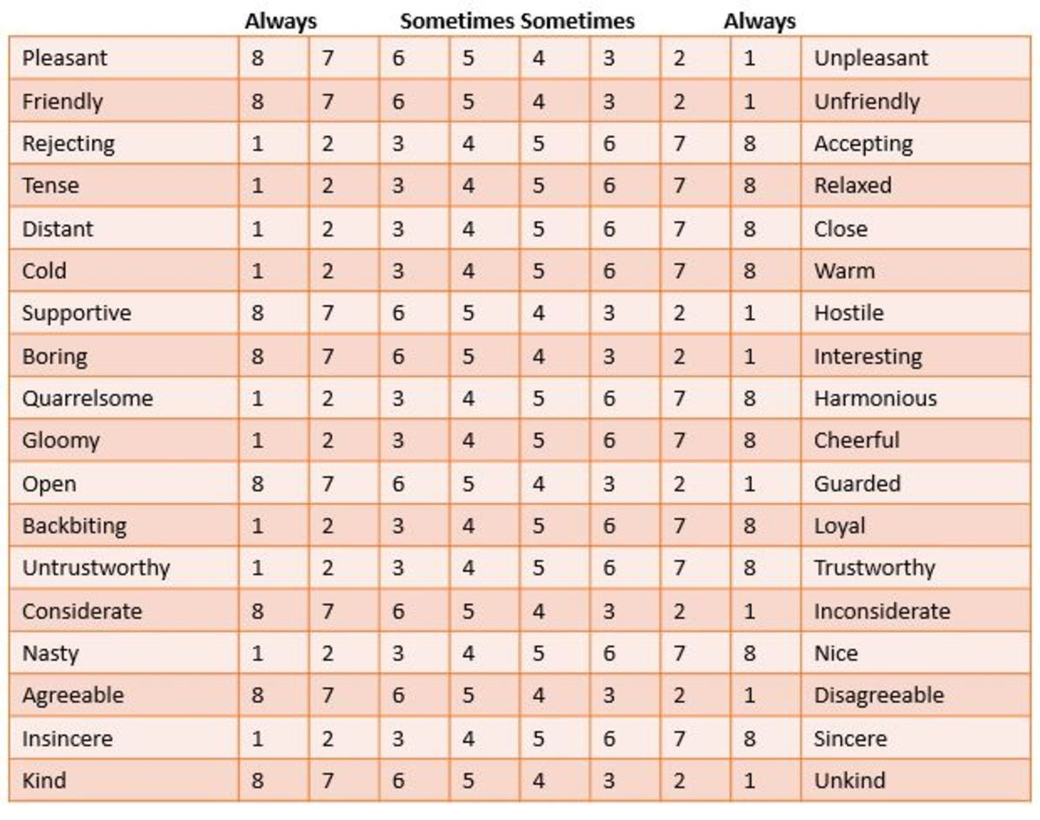
Fred Fiedler is the father of Contingency theory of Leadership

Slide 40
Fiedler’s Contingency Theory
Fred Fiedler is the father of Contingency theory of Leadership
This theory assumes that a leader is either task oriented or relationship oriented.
But the difference between this and behavioral theories is that in this theory, such behavior is difficult to change.
There are 3 variables which turn to be favorable for a leader -
Leader member Relations
The degree to which members respect and trust their leader.
Task Structure
The degree to which the job assignment are procedural.
Positional Power
The degree of influence leader has over power variables like hiring, firing, and promotion.

Slide 41
Favorableness of the Situation
Degree to which situation enables the leader to exert influence over the group
Most favorable Position
Good leader member relations
Most Unfavorable Position
Bad leader member relations
High task structure
Strong Position power
Low task structure
Weak position power

Slide 42
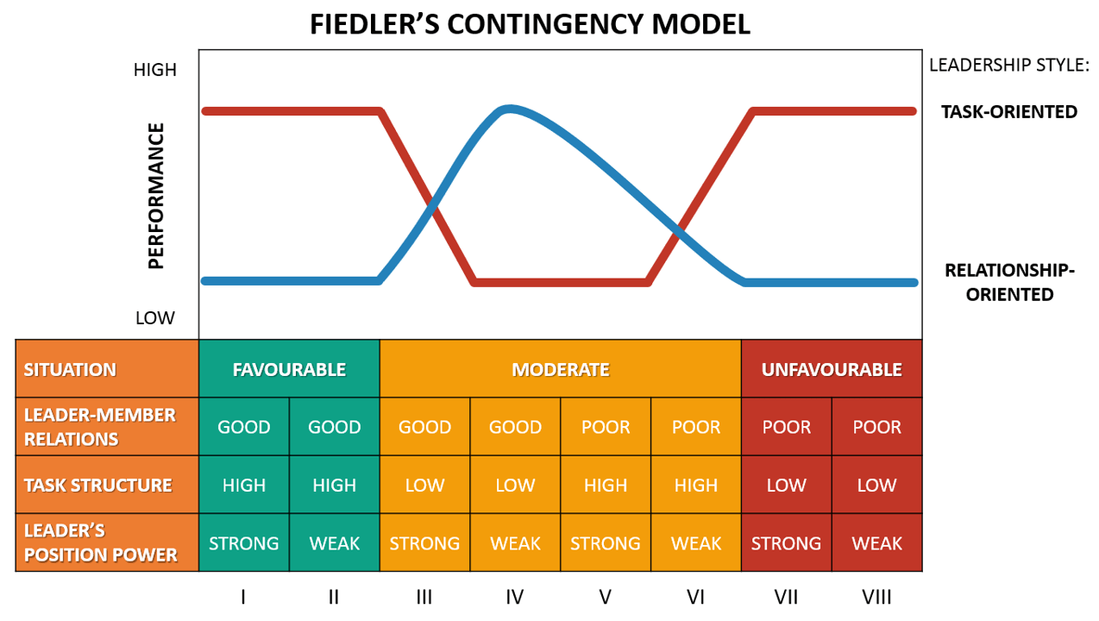
FIEDLER’S CONTINGENCY MODEL

Slide 43
Criticism
He assumed that leadership style is fixed. This means that no way you can improve the style.
Only two alternatives left –
Change the leader
Change the situation
The Model only considered three situations. However, practically there could be different situations.

Slide 44
ROBERT HOUSE’S PATH GOAL THEORY
This theory is closely related to expectancy theory of Motivation
The essence of this theory is that a leader’s job is to allocate resources, clarify goals to subordinates and create a work environment which clears path for the subordinates in achieving their goals.
Since it is contingency theory, leader’s effectiveness depends upon the characteristics of the environment and subordinates.

Slide 45
ROBERT HOUSE’S PATH GOAL THEORY
This theory is closely related to expectancy theory of Motivation
Directive leaders…… give specific guidance how to accomplish tasks
Supportive leader…..those who are friendly in nature and shows concern for the followers
Participative leaders ….. Those who like to take suggestions from the followers before making decision
Achievement oriented leaders…… sets challenging goals and expects followers to perform at highest level.

Slide 46
Types of Leader Behaviour
Directive – Task oriented
Supportive – employee oriented
Participative
Achievement oriented
Follower Path Perception
Effort – Performance
Reward linkages
Follower Motivation and Satisfaction
SITUATIONAL FACTORS
Follower Characteristics
Ability level
Locus of control – internal and external
Workplace Characteristics
Task Structure
Authority System

Slide 47
Criticism of the Model
The model is too complex to test
The model had mixed support from different researchers
The results suggested that the role of the effective leader is not just to removing roadblock.

Slide 48
HERSEY – BLANCHARD SITUATIONAL MODEL
This model is called as LIFE CYCLE theory of leadership
The theory was proposed by Dr. Paul Hersy, and Kenneth Blanchard
It is based on contingency theory of leadership
This is one of the first theory of leadership that focused “followers”.
The theory proposed that no body can be a leader without “follower readiness”.
The concept of follower readiness:
Followers accept or rejects the leader
Readiness refers to the extent to which people have the ability and willingness to accomplish a specific task.

Slide 49
HERSEY – BLANCHARD SITUATIONAL MODEL
This model is called as LIFE CYCLE theory of leadership
The situational theory of leadership suggests that no single leadership style is best.
Instead, it all depends on the situation at hand and which type of leadership and strategies are best-suited to the task.
According to this theory, the most effective leaders are those that are able to adopt their style to the situation.
Nature of task, the nature of the group, and other factors might influence the leadership style.

Slide 50
Four possible Outcomes
Able + Willing…………………………Laissez Faire Style
Able + Unwilling……………………..Participative Leadership
Unable + Willing……………………..Directional Leadership
Unable + Unwilling………………....High Task Orientation

Slide 51
HERSEY – BLANCHARD SITUATIONAL MODEL
This model is called as LIFE CYCLE theory of leadership
This theory assumes that a leader must adopt his leadership style based on maturity level of followers. And this maturity level moves in stages and has a cycle.
Called Situational Leadership Theory (SLT).
It is based on interaction between 3 variables
Variables
Task Behavior
Relationship Behavior
Maturity Level
Maturity is the ability and willingness of followers to take responsibility
People have varying levels of maturity – R1. R2, R3 and R4.
Every level will have different leadership style

Slide 52
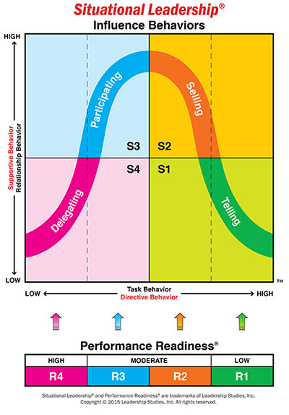
These are defined as the four stages of followers readiness:
R1 – People are both unable and unwilling or too insecure to take responsibility to do something. They are neither competent nor confident
R2 – People are unable but willing to do the necessary tasks. They are motivated currently but lack appropriate skills.
R3 – People are able but unwilling
R4 – People are both able and willing to do what is asked of them. They are at a very high level of maturity.

Slide 53
4 Leadership Styles
Telling Style: In this leadership style, the leader tells people what to do and how to do it.
Selling Style: Leaders “Sell” their ideas and message to get group members to buy or convince into the process.
Participating Style: In this approach, the leader offers less direction and allows members of the group.
Delegating Style: In the fourth stage, of low task and low relationship behavior delegating style of leadership is suitable. Subordinates in this stage are at a very high level of maturity, i.e., they have ability as well as willingness to work. Thus, they hardly require any leadership support.

Slide 54
VROOM – YETTON AND JAGO’S CONTINGENCY MODEL
Motive – Identify best leadership style & best decision making approach based on current situation
It was given by Victor Vroom and Philip Yetton in book – “Leadership and Decision Making” and later modified by Vroom and Jago.
Effective leaders are one who take good decisions and those require participation from subordinates.
This focus on the degree to which subordinates should be allowed to participate in decision is based on 3 factors.
Factors
Quality of Decision (Resources available)
Team Commitment (Decision’s impact on team)
Time Constraints
(Availability of time)

Slide 55
5 Leadership Styles
Autocratic I (AI): A leader solves a problem using information that is readily available.
Autocratic II (AII): A leader obtains additional information from subordinates and then solves the problem.
Consultative I (CI): A leader shares the problem with subordinates on an individual basis and obtains their ideas and suggestions. Further, the leader chooses a solution to the problem at hand.
Consultative II (CII): A leader shares the problem with subordinates as a group. The final decision may or may not reflect subordinate input.
Group (G): A leader meets the subordinates as a group. However, he or she acts as a chairperson who focuses and directs discussion, but does not impose his or her will on the group. Subordinate’s participation is sought.

Slide 56
Quiz
What does situational theory of leadership emphasize?
a) Personality traits
b) Events
c) Environment
d) Political situation

